Slide 1


HR Analytics Data- Driven Approach Present by, Mohd Aftab
What is HR Analytics ?

Slide 2
Definition HRA
HR Analytics involves data-driven decision-making to improve workforce management, recruitment, performance, and retention

Slide 3
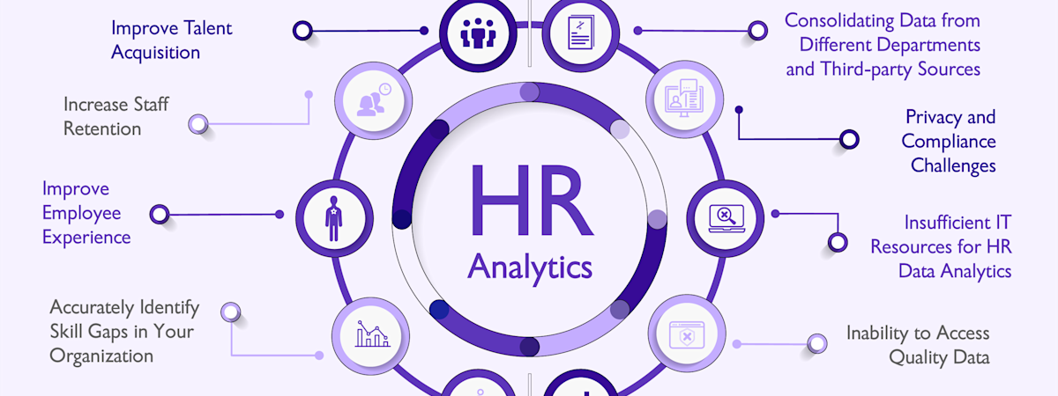
Benefits of HR Analytics
Data-driven recruitment decisions
Improved employee retention strategies
Better workforce planning

Slide 4
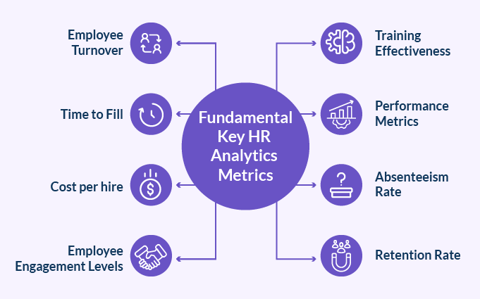
Key Metrics in HR Analytics
Employee Turnover Rate
Time-to-Fill and Time-to-Hire
Employee Engagement and Satisfaction
Absenteeism Rate
Diversity and Inclusion Metrics
Training Effectiveness

Slide 5
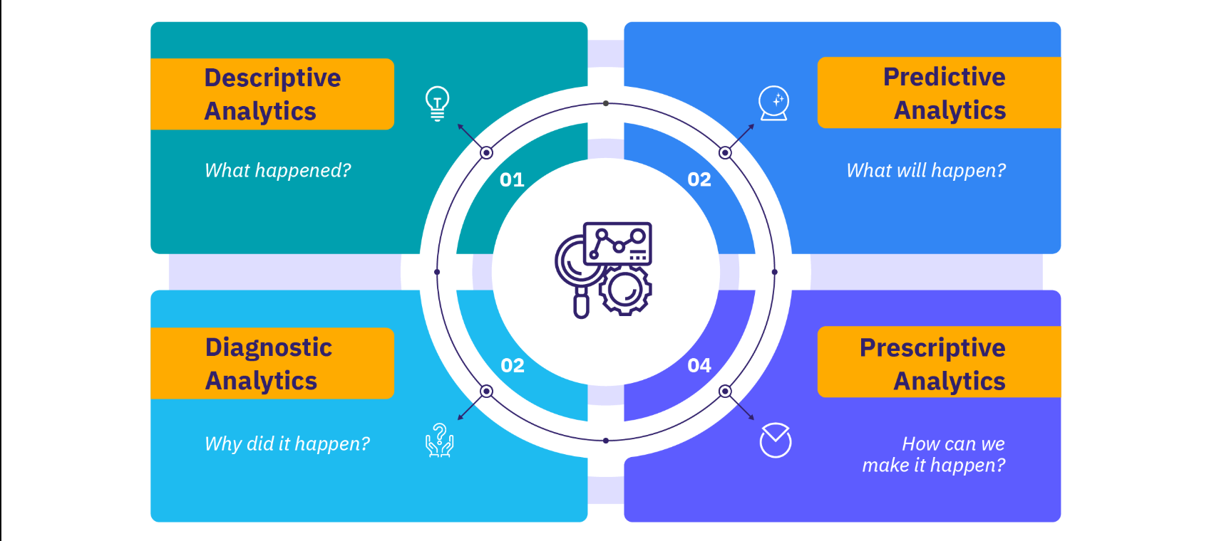
Type of HR Analytics
Descriptive Analytics: Understanding past trends
Predictive Analytics: Forecasting future trends
Prescriptive Analytics: Recommending actions

Slide 6
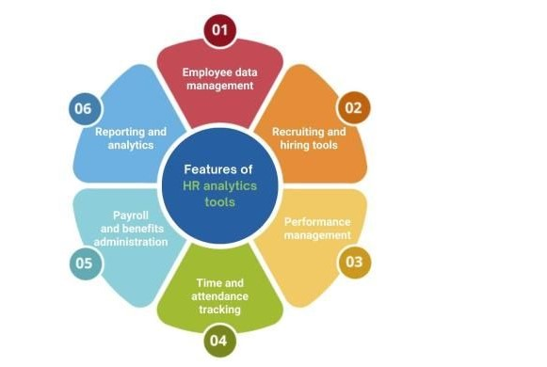
Tools & Techniques in HR Analytics
Power BI, Tableau, SQL, Python, Excel
Techniques: Regression Analysis, Machine Learning, Sentiment Analysis, Predictive Modeling

Slide 7
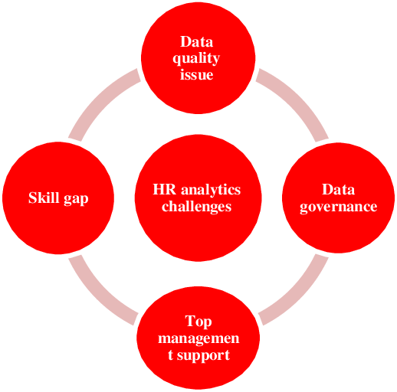
Challenges in HR Analytics
⚠️ Data privacy and security concerns ⚠️ Integration of HR systems ⚠️ Resistance to change from HR teams ⚠️ Data accuracy and consistency

Slide 8
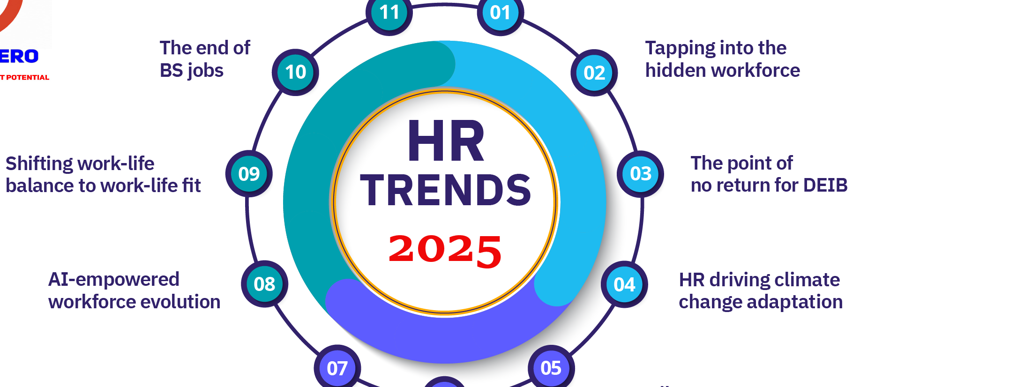
Future Trends in HR Analytics
AI-driven HR Analytics
Real-time HR dashboards
Employee sentiment analysis

Slide 9

Conclusion
HR Analytics is revolutionizing workforce management, making HR more strategic and data-driven. Organizations that leverage HR analytics gain a competitive advantage in hiring, retaining, and managing talent

